Slide 1

NLP-Module 6
Hazina
DCS KU

Slide 2
Named Entity Recognition and Relation Extraction
An information extraction technique that identifies key elements from text then classifies them into predefined categories.
Text appears as unstructured data in several formats such as document files, spreadsheets, web pages and social media.
Need for NER!
With hundreds of documents to review, or to investigate, its hard to obtain the content for related purpose.
So,-Entity extraction is performed.

Slide 3
Entity Extraction
Entity extraction can provide a useful view of unknown data sets by immediately revealing who and what the information at a minimum.
In a structured corpus that they can use as a point of departure for further analysis and investigation.
Must address a number of language issues to correctly identify and classify entities.
The ambiguities of language make this an especially complex task for machines.
Part Of Speech Tagging (main challenge)
EE-This function reveals direct relationships, connections or events shared between different entities as well as complex relationships through inferred, indirect connections. This helps to better summarize information in a quick and efficient manner.

Slide 4
Relation Extraction
Extracting relations among named entities using NLP.
Consider these sentences.
Maya Mytri works at Infosys. Apple is located in Cupertino.
Detect the various entities in these sentences.
Person name = Maya Mytri Company = Infosys Company = AppleCity = Cupertino
Deduce the relationships using NLP
works_at(person: Maya Mytri,company:infosys) located_in(company:apple, city:cupertino)

Slide 5
Contd.
POS tags carry strong signals towards identifying the relational phrases.
Also named entity recognition would have already tagged the named entities in these sentences which would additionally make easier.
Tokens: Maya Mytri works at Infosys POS tags: noun noun verb preposition noun NER tags: person person — — companyTokens: Apple is located in Cupertino POS tags: noun verb verb preposition noun NER tags: company — — — city
combining the information in the POS tags with those in the NER tags works well to identify the relational phrases.

Slide 6
Contd.
Consider this sentence,
Read The Adventures of Sherlock Holmes by Arthur Conan Doyle online or in your email
Named entities are The Adventures of Sherlock Holmes, a book title, and Arthur Conan Doyle, a person’s name.
(Relational phrase still sits between them after recognizing)
-This sentence has the structure;
<words> book-title by person-name <words>
POS analysis=
NER= Able to infer that the book title always precedes the by and that the person's name always follows it

Slide 7
Contd.
Wimbledon is a tennis tournament held in the UK in the first two weeks of July every year.
could be ‘parsed’ via entity recognition;
Sports event name is a sport tournament held in the location in the time.
phases of recognition
Sports event name is-a sport tournament.=it is crisp and hence get easily trained and tested with maximum accuracy, but held in may be wrong inference so, we have inferences,
ST=tennis tournament, held-in ⇒ L=UK SEN=Wimbledon, held-in ⇒ L=UK SEN=Wimbledon, ST=tennis tournament, held-in ⇒ L=UK

Slide 8
Mathematical inference/generalization
IF X THEN Y;
he support of a rule X ⇒ Y is the number of sentences in which X holds. The confidence of this rule is P(Y|X).
In X ⇒ Y, Y is always T = first two weeks of July every year. X is any nonempty subset of {SEN=Wimbledon, ST=tennis tournament, L=UK}

Slide 9
Information Extraction using sequence labeling
Information Extraction is the process of parsing through unstructured data and extracting essential information into more editable and structured data formats.
Information Extraction NLP techniques,
Tokenization
Parts of Speech Tagging
Dependency Graphs
NER with Spacy

Slide 10
Sequence Labeling
Sequence labeling is a fundamental technique in NLP that is used to identify and label the components of a sequence, such as words or phrases in a sentence.
A preprocessing step for other NLP tasks
In Information Retrieval, it helps to clarify the context and meaning of a query. Additionally, sequence labeling is employed in machine translation to identify the grammatical structure of a sentence and to facilitate the translation process.
POS and Named Entities are useful clues to sentence structure and meaning
POS tagging- taking a sequence of words and assigning each word a part of speech like NOUN or VERB
NER- assigning words or phrases tags like PERSON, LOCATION, or ORGANIZATION.

Slide 11

contd,.
Each word $x_{i}$ in an input word sequence, a label $y_{i}$ , so that the output sequence Y has the same length as the input sequence X are called Sequence Labeling Tasks

Slide 12
Approaches to Sequence Labeling Tasks
There are multiple ways to perform those tasks, and the method chosen can significantly impact the performance and outcome.
Rule-based approaches : These rely on a set of manually-defined rules going from predefined rules to tag each word in a sentence or identifying named entities in text. These do the job for simple tasks but can be error-prone and time consuming.
Machine learning-based approaches : These approaches use machine learning techniques to learn the patterns for the given tasks from annotated training data. They range from Stochastic approaches to Deep learning-based approaches such as Transformers.
Hybrid approaches : These approaches combine the strengths of rule-based and statistical approaches, using a combination of hand-written rules and machine learning techniques to identify arguments and roles.

Slide 13
Type of Sequence Labelling
Part of Speech Tagging-Part of speech tagging problem generate different
Part of speech tag -from an input sentence
For example: I eat rice -> PRON VERB NOUN
Lemmatization-Lemmatization predict different lemma from an input sentence (reduce a word to its root form/grouping together different inflected forms of the same word)
He ate Rice-> He eat Rice
Language Identification
Language identification predict different language type from an input sentence
el comio arroz-Spanish
NER

Slide 14
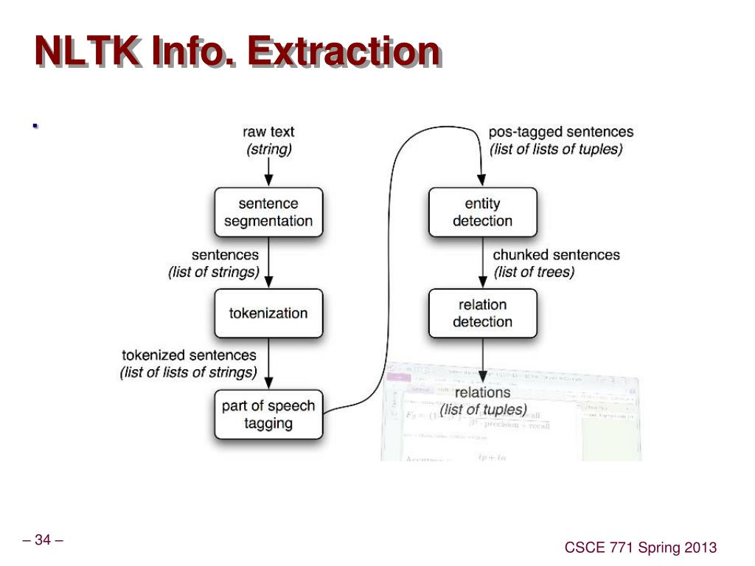

Slide 15
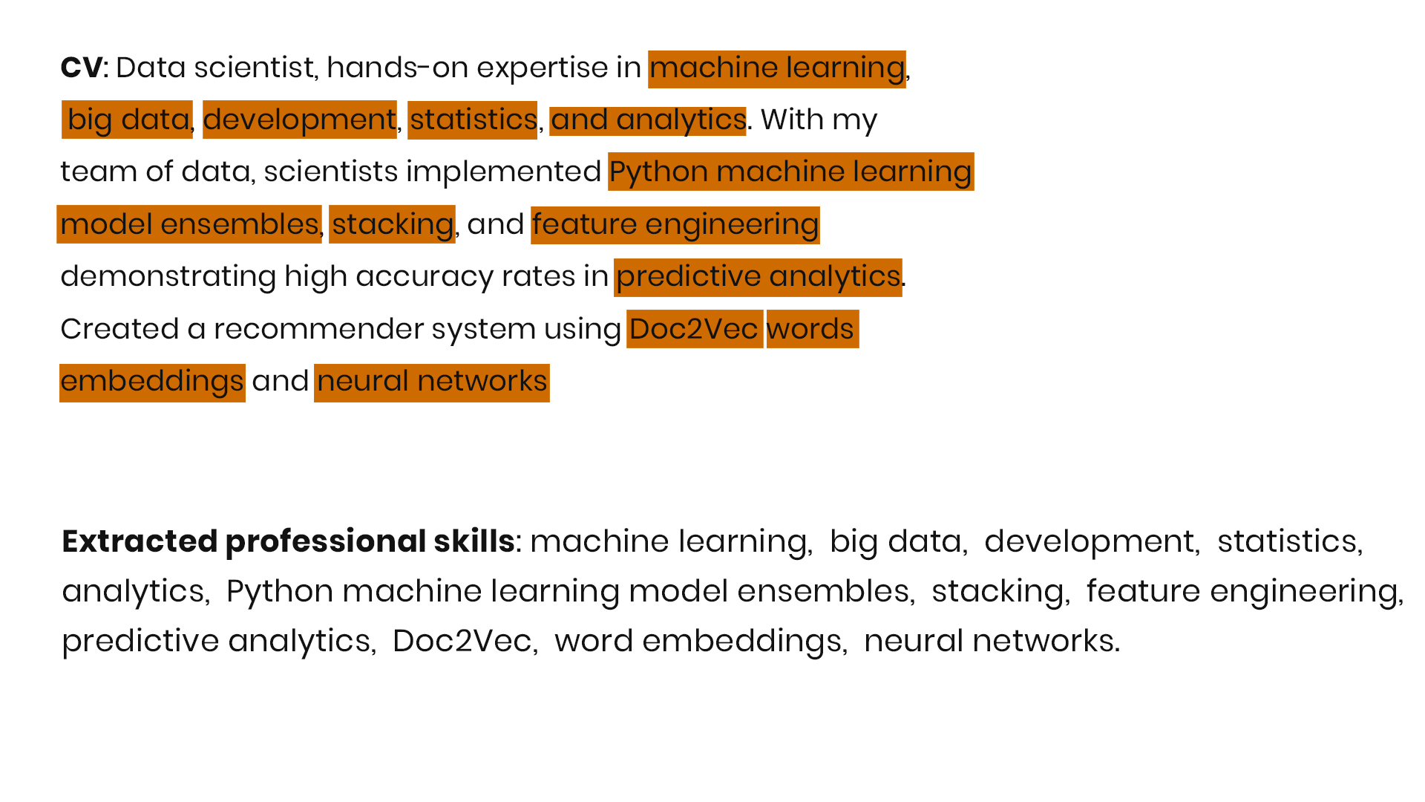
example

Slide 16
5 Conditional Random Fields (CRFs)

Slide 17
Machine Translation in NLP?

Slide 18
viterbi

